Slide 1
Heart Failure Prediction
Presented By
Sayali Pawar
Divya Davra

Slide 2
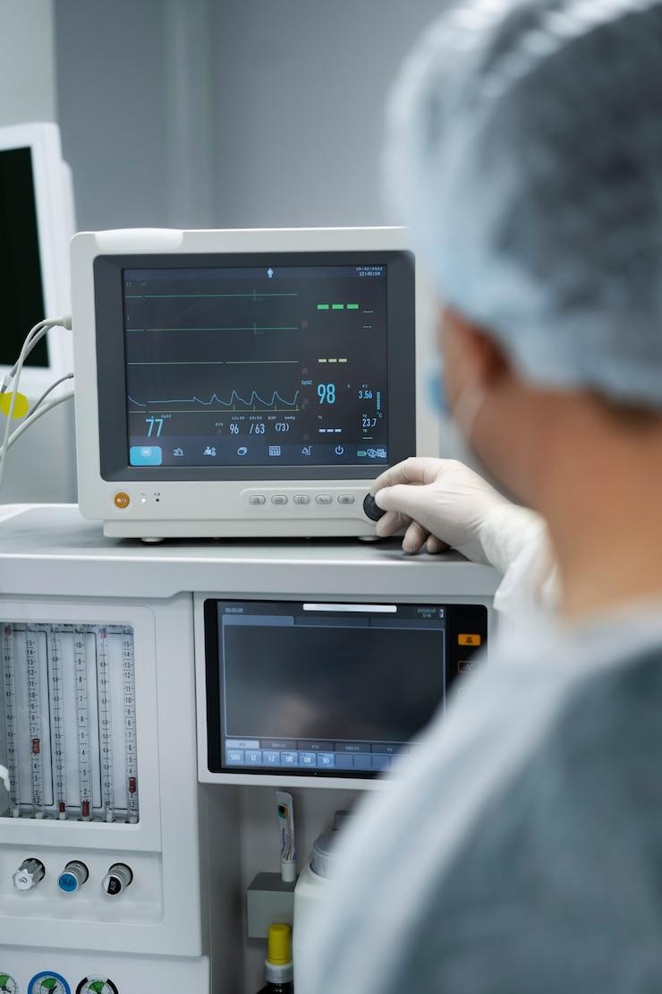
Introduction
The aim of this research was conducted to compare the heart failure prediction ratios of men and women. In addition, we use common symptoms such as cholesterol and ECG to compute the male to female heart failure ratio. Using data visualization and analytic tools, we create five prediction models, including machine learning models, to assess an individual's chance of getting heart failure.

Slide 3
Data Collection
Dataset:
https://www.kaggle.com/datasets/fedesoriano/heart-failure-prediction/discussion/412800
918 records and 12 variables
Age, Sex, ChestPainType, RestingBP, Cholesterol, FastingBS, RestingECG, MaxHR, ExerciseAngina, Oldpeak, ST Slope, HeartDisease.

Slide 4
Objectives :
Develop a Predictive Model for heart failure.
Identify Key Predictors
Validate and evaluate model performance
Cardiovascular health research:
Enable early detection and intervention.
Analyze the ratio between Male and Female.
Heart Disease Prediction Outcomes

Slide 5
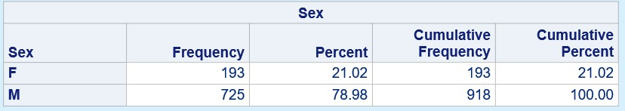
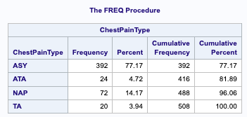
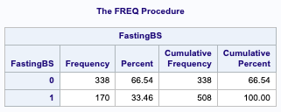
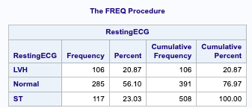
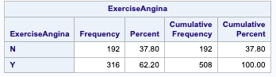
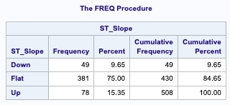
Frequency Table:

Slide 6
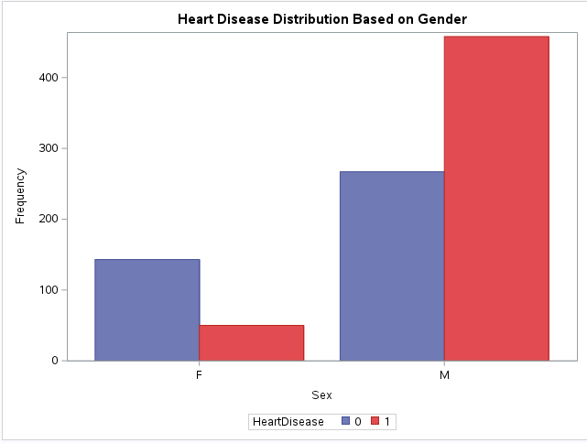
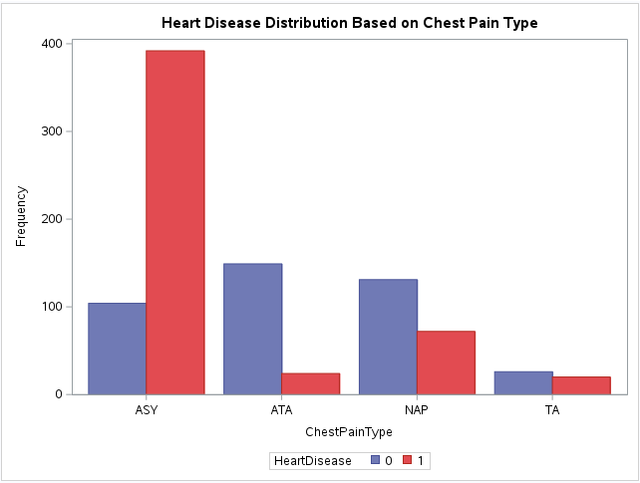
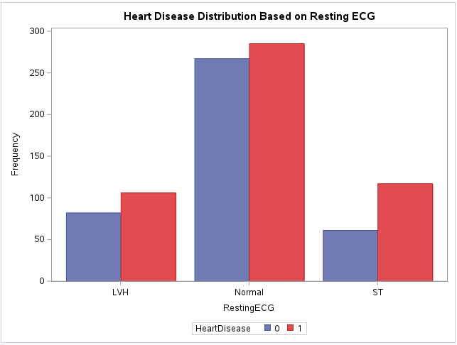
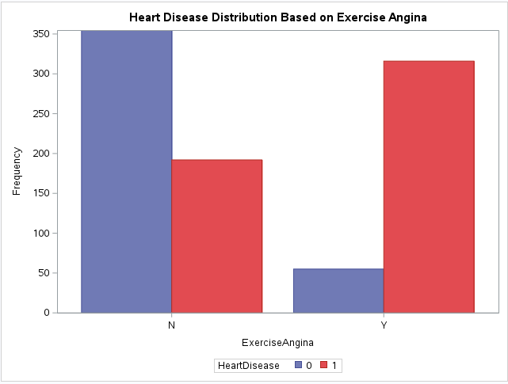

Slide 7
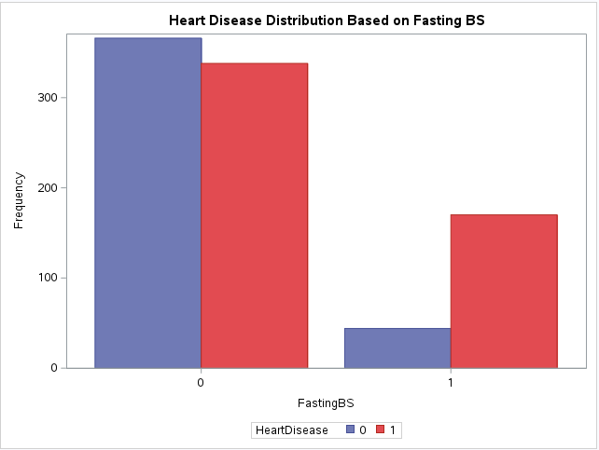
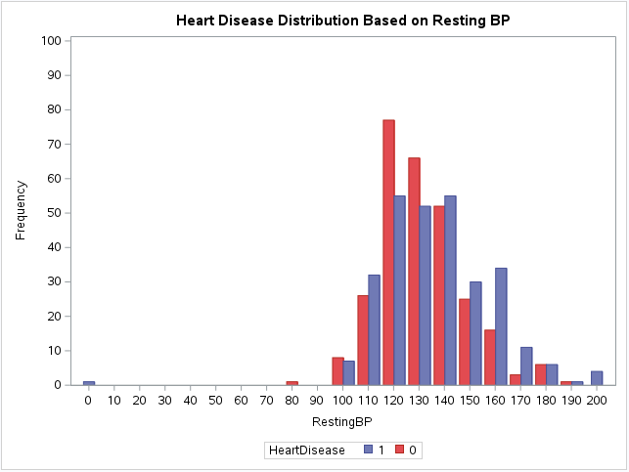
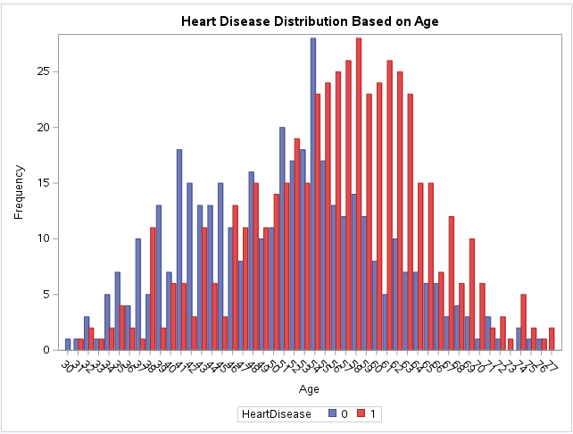

Slide 8
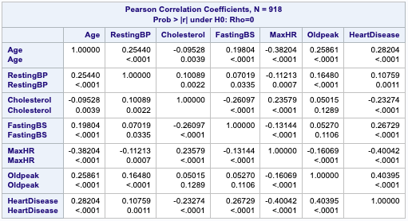
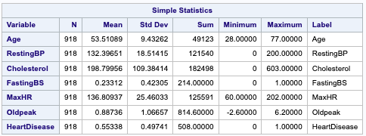
Correlation Matrix

Slide 9
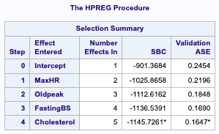
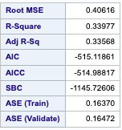
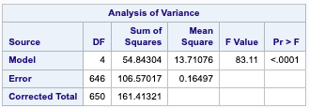
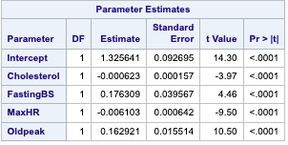
High Performance Regression Model:

Slide 10
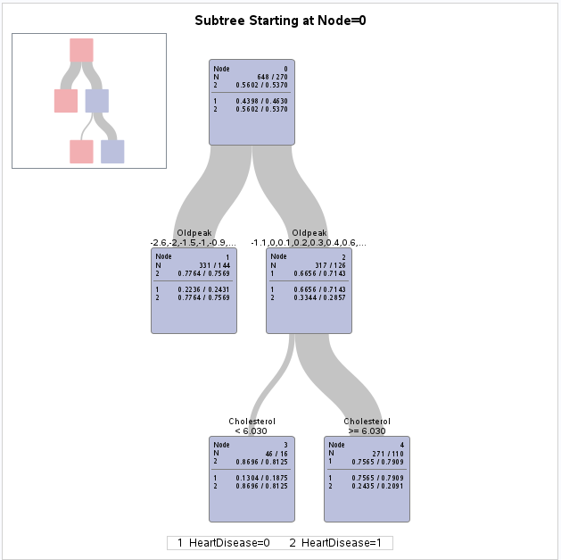
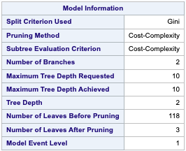


Decision Tree:

Slide 11
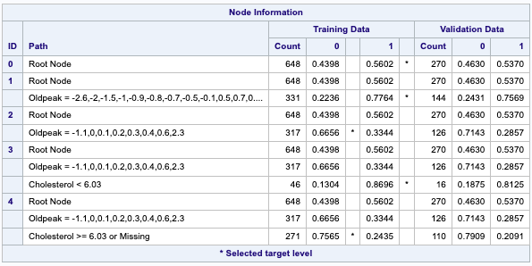
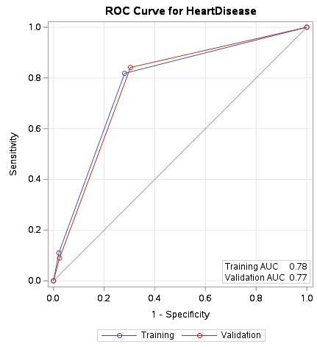
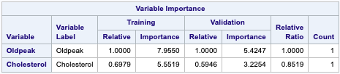
Decision Tree:

Slide 12
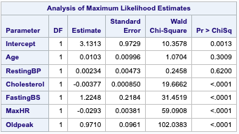
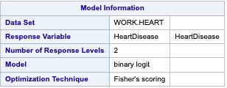
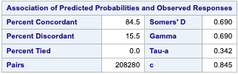
Logistic Regression Model

Slide 13
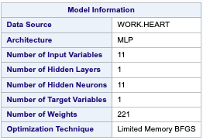

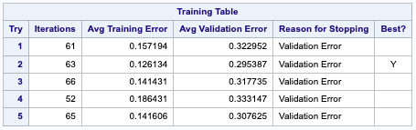

Neural Network:

Slide 14
Accuracy of Models:
Regression Model Accuracy: 34% indicates low - performance prediction.
Decision Tree Accuracy: 77% indicates moderate performance prediction.
Logistic Regression Accuracy: 86% Moderate performance prediction.
Neural Network Accuracy: Good Fit Model. Misclassification rate is 10.88% for training and 10.94% for validation.

Slide 15
Thank You!

